Slide 1

E-commerce Data Analysis and Recommendation System
“Leveraging User Behavior for Enhanced Product Experiences”
s
by Solomon Sannie
Azubi Africa

Slide 2
Project Overview: Unlocking User Insights
Our Core Goal
Driving Objectives
Analyze e-commerce data to deeply understand user behavior, predict critical item properties, identify abnormal user patterns, and develop sophisticated recommendation algorithms.
Enhance the product page experience.
Improve overall user engagement.
Significantly increase conversion rates.
Our insights are powered by three key data sources: events.csv (user interactions), item_properties.csv (item attributes) and category_tree.csv (category hierarchy).

Slide 3
Unanswered Questions: Our Analytical Quest
Interaction Frequency
User Segmentation
Which products or content are most frequently interacted with by users?
Which user segments exhibit similar purchase or viewing behaviors?
Temporal Dynamics
Conversion & Transactions
How do seasonal trends affect product/content interactions, and when does purchase activity peak?
What is the visitor-to-purchase conversion rate, and what are the total transactions over time?

Slide 4




Methodology: Anomaly Detection
Purpose
Method
To identify unusual user behaviors, which could indicate bots, fraudulent activity, or highly atypical user journeys.
Utilizing the Isolation Forest model, a powerful unsupervised learning algorithm well-suited for outlier detection in high-dimensional datasets.
Key Features
Outcome
Focused on aggregated user metrics: total number of events, average time spent per session, and unique item interactions per user.
Successful identification of 7.63% abnormal users, enabling targeted interventions for security measures or customized user experiences.

Slide 5

Methodology: Item Property Prediction
Our objective was to infer specific item properties (e.g., categoryid, and available) within 'addtocart' events by leveraging known properties from preceding 'view' events for the same user or session. This enriches our understanding of the user's intent even when direct property data is absent.
Models Utilized:
RandomForest Classifier
LightGBM
TNN (Tabular Neural Network)
The models were trained on comprehensive visitor viewing behavior features, allowing us to predict the most likely item properties, thereby enhancing the dataset for more accurate recommendation systems.
XGBoost

Slide 6
Methodology: User Segmentation
"Understanding our diverse user base is key to personalized engagement."
1
2
Purpose
Methodology
To group users with similar interaction patterns and behavioral traits into distinct segments. This enables tailored marketing strategies and product adjustments.
We employed K-Means Clustering, an unsupervised machine learning algorithm, which groups data points into a predefined number of clusters.
3
4
Features
Outcome
Leveraged a rich set of user behavior features derived from event logs, including frequency of visits, types of interactions, and pages viewed.
Identified clear user segments: Less Engaged, Moderately Engaged, and Highly Engaged. Each segment can now receive optimized content and offers.

Slide 7
Methodology: Recommendation System
Personalizing the E-commerce Journey
Our goal was to provide users with highly personalized and relevant item suggestions, driving both engagement and conversions.
Content-Based Filtering
Collaborative Filtering
Recommending items similar to those a user has liked in the past, based on item properties (e.g., category, brand, features).
Suggesting items based on user-item interactions, leveraging the preferences of similar users (user-user) or item similarities (item-item).
Hybrid Approach
Category-Based Recommendations
Combining the strengths of both Content-Based and Collaborative Filtering to overcome limitations and enhance recommendation accuracy and diversity.
Leveraging the category hierarchy to recommend broader or narrower selections of products, adaptable to user exploration patterns.

Slide 8
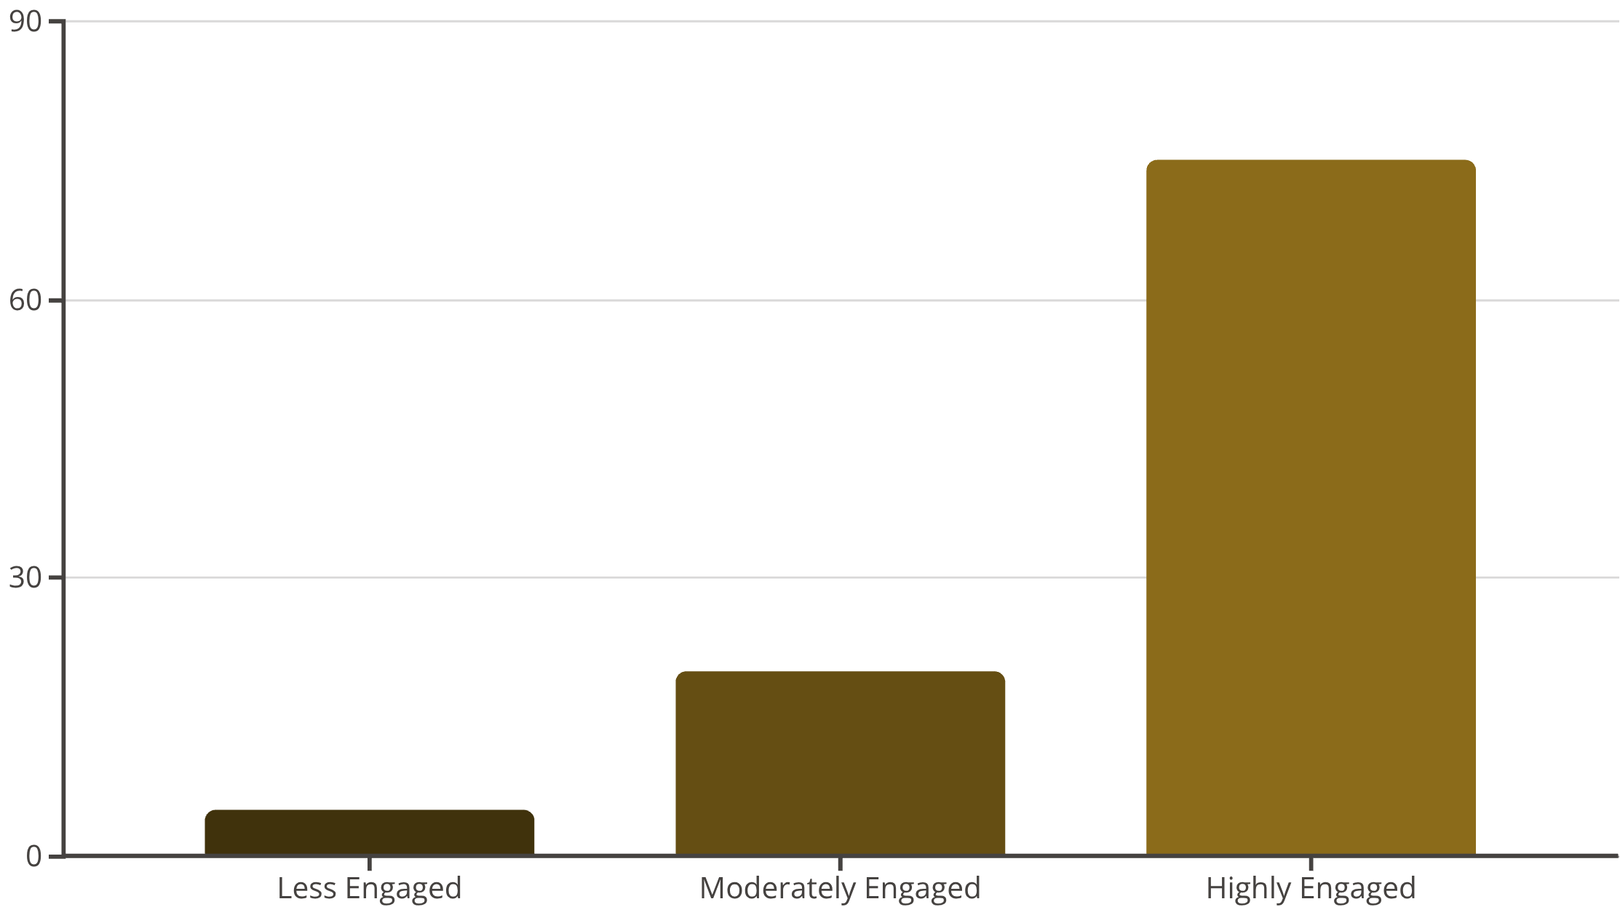
Key Results & Insights: User Behavior
User Segments: Our clustering identified clear distinctions, from infrequent browsers to power users, enabling tailored interventions.
Temporal Trends: Analysis revealed peak activity during evening hours (7 PM - 10 PM) and consistent high engagement on weekdays,
suggesting prime times for promotions.
Item Popularity: Key items and content frequently interacted with were identified, providing insights for inventory management and content strategy.

Slide 9

Key Results & Insights: Predictive Modeling
Anomaly Detection Success
Item Property Prediction Robustness
Our Isolation Forest model effectively identified users exhibiting abnormal behavior patterns, ranging from bot-like activity to potential fraudulent interactions. This allows for proactive security measures and cleaner data for legitimate user analysis.
The classification models, particularly RandomForest, demonstrated strong performance in predicting missing item properties from viewing data, achieving an impressive F1-score of around 0.84. This validates our ability to enrich sparse datasets and improve recommendation accuracy.

Slide 10
EDA Insights: Purchase Behavior
7.63%
187946
0.83%
461686
Abnormal Users
Most Viewed Item ID
Low Conversion
Most Added to Cart
Only a small fraction of users in the sampled data was classified as abnormal in the system and was removed from the dataset for further analysis.
The visitor-to-purchase conversion rate.
This product received the highest number of views across all sessions
This item was most frequently added to shopping carts by users

Slide 11

EDA Insights: Predictive Analysis
320130
Most Predicted Item ID
This item was most frequently predicted.

Slide 12




Actionable Solutions: Enhancing Product Pages
Leveraging our analytical insights, we've identified key strategies to optimize product pages for improved user experience and conversion.
Personalized Recommendations
Segment-Specific Content
Implement our hybrid recommendation engine to dynamically suggest relevant products, increasing user engagement and potential purchases.
Customize product page layouts and content based on user segments, offering detailed information for highly engaged users and simplified views for less engaged ones.
Seasonal & Trend Highlights
Anomaly-Aware Experience
Dynamically showcase items that are popular during the current season or trending periods, aligning with user interest and maximizing sales opportunities.
Integrate insights from anomaly detection to tailor the experience for unusual user behavior, applying security checks or adjusted content to maintain platform integrity.

Slide 13



Actionable Solutions: Broader Impact
Beyond product page enhancements, our analytical framework offers widespread benefits across marketing, operations, and security.
Targeted Marketing Campaigns
Temporal Trend Optimization
Enhanced Security Protocols
Develop and deploy marketing strategies precisely crafted for identified user segments, enhancing conversion rates and customer loyalty through personalized content and offers.
Optimize website content delivery, promotional timings, and server load management by aligning with peak user activity periods, improving user experience and resource allocation.
Integrate anomaly detection insights into real-time security systems to proactively identify and mitigate fraudulent activities and bot attacks, ensuring platform integrity and user safety.

Slide 14




Next Steps
To fully realize the potential of our analysis and continue optimizing the e-commerce experience, we propose the following key actions:
Productionize Algorithms
Conduct A/B Testing
Deploy the developed recommendation and tailoring logic into live systems, ensuring seamless integration with the e-commerce platform.
Implement rigorous A/B tests to quantitatively measure the impact of new recommendations and tailored experiences on key business metrics like conversion rates and engagement.
Explore Advanced Modeling
Gather User Feedback
Continuously investigate and integrate more sophisticated machine learning techniques to further enhance predictive accuracy and personalization capabilities.
Establish continuous channels for collecting direct user feedback, which will be invaluable for iterative improvements and identifying new areas for enhancement.

Slide 15

Thank You
Questions?

